Slide 1
Grants administration –
External monitoring
Candace “Candy” Pilkington
External Audit Supervisor
Candace.Pilkington@education.ohio.gov
614-387-0245

Slide 2
Topics
Subrecipient Monitoring
Single Audits
Cash Management
Time and Effort
Fiscal Reviews
Common Issues

Slide 3
Subrecipient monitoring
Under 2 CFR Part 200, grantee monitoring of subrecipient activities is required to ensure that (1) subawards are used for authorized purposes, in compliance with Federal statutes, regulations, and the terms and conditions of the subaward, and (2) subaward performance goals are achieved.
Under Section 2 CFR §200.92 (see also §200.93 for definition of a subaward) in the new Uniform Guidance, a subrecipient is defined as a recipient of a subaward from a pass-through entity to carry out a portion of the federal award.

Slide 4
Single audits
Single Audit, previously known as the OMB Circular A-133 audit, is an organization-wide financial statement and federal awards’ audit of a non-federal entity that expends $750,000 or more in federal funds in one year.
Requirements:
Audits must be performed in accordance with GAGAS (Generally Accepted Governmental Auditing Standards) by an independent auditor.
An Audit includes review of the following:
Financial statements. The auditor must determine whether the financial statements of the auditee are presented fairly in all material respects in accordance with generally accepted accounting principles.
Internal control. A review is made on internal controls over Federal programs based upon the guidance in Standards for Internal Control States and the Internal Control— Integrated Framework, issued by the Committee of Sponsoring Organizations of the Treadway Commission (COSO).
Compliance. The auditor must determine whether the auditee has complied with Federal statutes, regulations, and the terms and conditions in the Federal Government issued by the Comptroller General of the United of Federal awards that may have a direct and material effect on each of its major programs.

Slide 5
Cash management
Cash management is an important part of business success.
Cash management involves tracking your cash needs and meeting cash needs as they occur.
Cash management controls ensure accountability and safeguard grant funds. To help ensure grant funds are used as intended, grantees are expected to receipt and track grant funds properly and funds must be disbursed promptly on allowable expenditures under the grant.
The integrity of an organization's cash management activity is dependent upon the implemented internal controls.
Implementation of strong internal controls ensures that grant funds are utilized properly and that cash transactions only take place with the approval of a delegated authority. Part of cash management controls is the maintenance of written processes for securing payments.

Slide 6
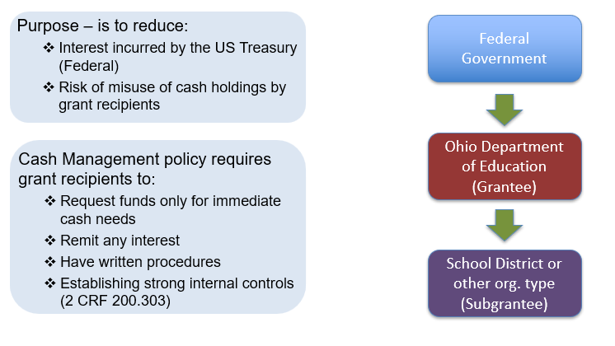
Cash management

Slide 7

Cash management

Slide 8

pcr cash advance

Slide 9
Time and effort
To provide reasonable assurance that payroll charges are accurate when effort is allocated across multiple duties/awards, IC policy should include a consistent method for measuring, tracking, reviewing, and adjusting staff effort to accurately charge the appropriate funding sources that benefitted from the effort.
• Measurement methods should be consistent across staff classifications.
• Tracking methods should be verifiable to allow for secondary review and approval.
• Review methods should assign responsibility for review and approval of measurement and tracking mechanisms to an accountable party for ensuring funding sources are accurately charged.
• Written policies and procedures reviewing and adjusting budget estimations should ensure the reported final amount charged to the Federal award is accurate, allowable, and properly allocated.

Slide 10
Fiscal reviews
Reviews will be completed through the Monitoring System by the External Monitoring group.
You will receive an email stating the grant has been selected for review.
Documents you will need to provide.
  Detailed financial report (Excel, QuickBooks, etc.).
  Payroll reports, Time and Effort.
  Copies of Purchase Orders (if used), Invoices, Checks/Bank Statements/Credit Card Statements showing how payment was made.
  Explanation of why the funds were used for the grant.

Slide 11
Common issues
Is the expense allowable? Is the expense reasonable? Is the expense necessary?
Does the document match the expense? If not, you must be able to explain why.
Was the expense in the budget? If not, the Program Office will have the final determination if expense is allowed.
Does the expense follow the intent of the grant?
Does the financial report match the Project Cash Request (PCR) or Final Expenditure Report (FER)?
Grant expenses should be kept separate from other funding.

