Slide 1
Jump stART Learning
Helen Buck-Pavlick, MFA, MEd (she/her)
Fine Arts Education Specialist
Office of Learning and Instructional Strategies
Helen.Buck-Pavick@education.ohio.gov

Slide 2

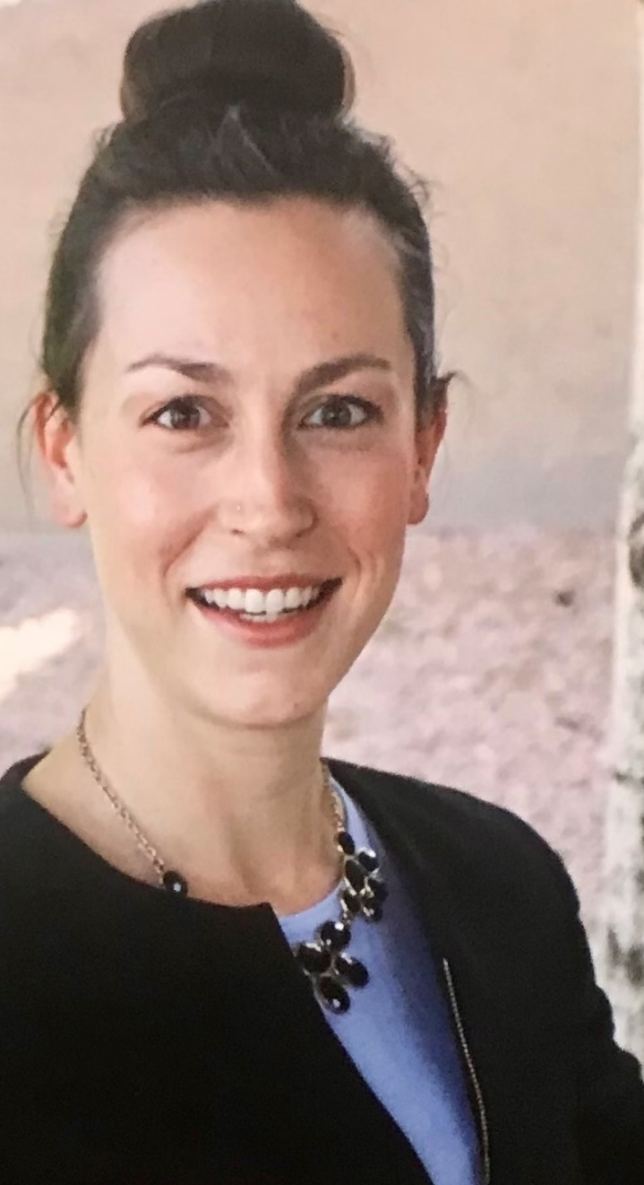
Meet Your Specialist
Love to travel (22 countries and counting)
Proud cat-mom to sphynx cat named Yoshi
(please ask me to show you pictures!)
20+ years teaching in K-12, higher-ed, studios
(mainly middle school)
P-12 Dance & Drama Certified Teacher – OH & AZ
Ph.D. Student Educational Policy – The Ohio State University, OH
M.Ed. Educational Foundations – Northern Arizona University, AZ
M.F.A. Dance – Arizona State University, AZ
B.A. Theatre, Minor: Music – North Central College, IL

Slide 3
Agenda
Time | What | Why | How
5 min | Opening Activity | To center ourselves and transition into learning. | Facilitator led activity
5 min | What is Arts-Integration? | To engage with our prior understandings, make connections that deepen our understandings, and improve our practice. | Individual reflection & group sharing
20 min | Experience 1 | To experience arts-integration in action. | Experiential Activity
5 min | Reflection & Questions | To provide time for questions, reflection, and thinking about how this will inform future work. | Group discussion
15 min | Resource Sharing | To gain resources that can be applied in individual contexts | Information Sharing
5 min | Reflection & Questions | To provide time for questions, reflection, and thinking about how this will inform future work. | Group discussion

Slide 4



Ninja Math Brain Teaser

Slide 5
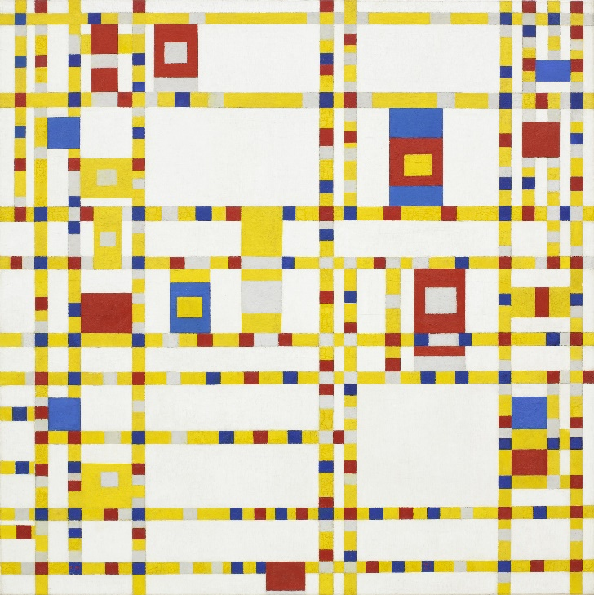
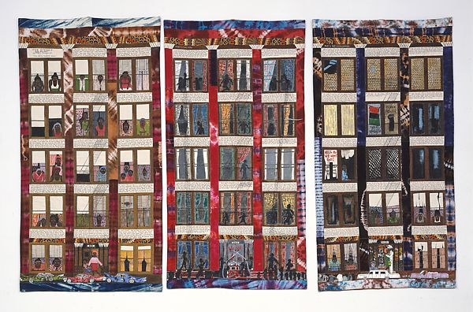
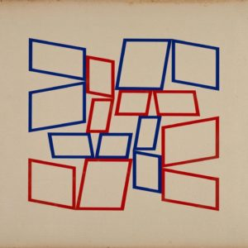
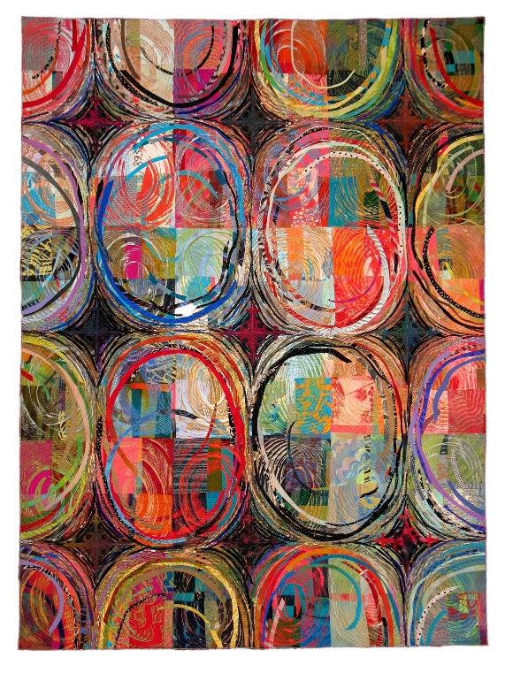
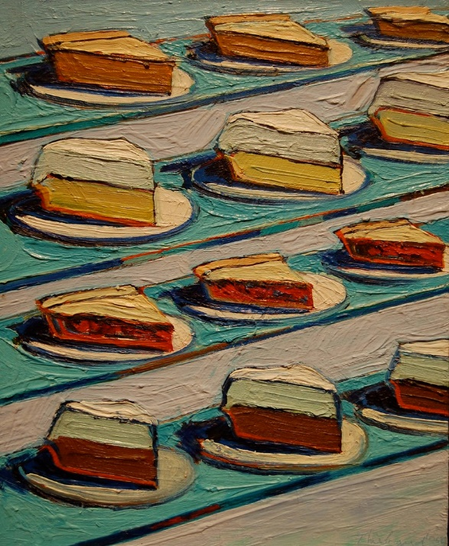

Slide 6
Arts Integration is…
(Kennedy Center for the Performing Arts)
Arts Integration is an approach to teaching in which students construct and demonstrate understanding through an art form. Students engage in a creative process which connects an art form and another subject area and meets evolving objectives in both.

Slide 7

Place Value Freeze Dance
Notes:
Place Value Freeze Dance
Lesson Procedure: Review place values of ones, tens, and hundreds. Demonstrate the body symbol for
ones: “I”
tens: “X”
hundreds: “C”
Play music and pause after a few seconds. Students should freeze. Students pick a one, ten, or hundred posture to freeze in.
Select a student and a helper buddy (optional) to count the students. Modeling how to count the ones, tens, and hundreds; and how each place value represents a different value.
Repeat

Slide 8
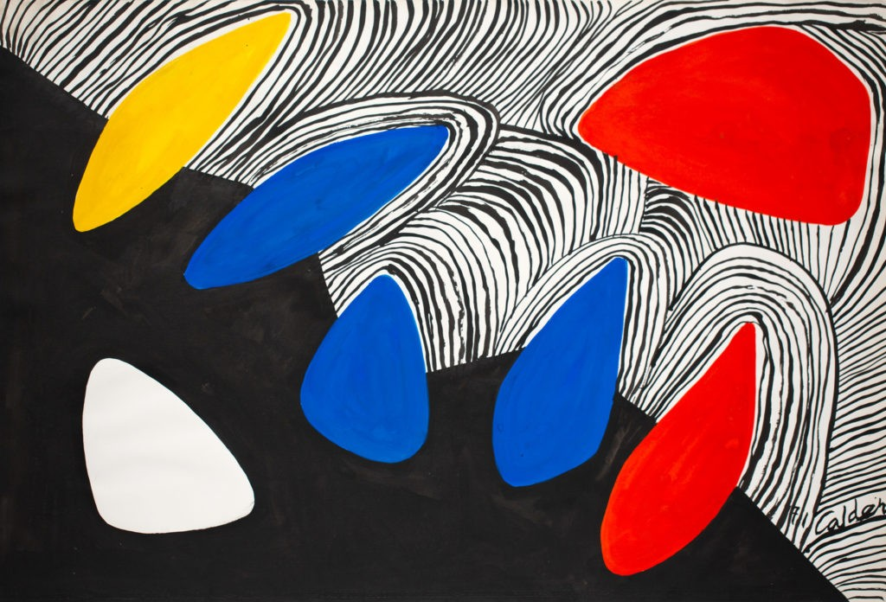
Calder Torn Paper Collage
Notes:
SEE HANDOUT (adapted from Opening Minds Through the Arts)
Image from: Glacier with Colored Petals (1971) | Calder Foundation

Slide 9

Musical Stories
Why are you grumpy today?
Why don’t you just go away?
I think I can make you smile if I stay here for a while.
I guess that would be alright.
I’m sorry that we had a fight.
Notes:
SEE HANDOUT (adapted from Opening Minds Through the Arts)

Slide 10

Dancing Cuyahoga Valley National Park
Notes:
SEE HANDOUT
Image from: https://wallpapercave.com/wp/wp2501482.jpg

Slide 11
“I don’t know where I am going from here, but I promise it won’t be boring” – David Bowie

Slide 12
Reflection
How was arts learning supported?
How was other content learning supported?
What stood out about this approach to T&L?

Slide 13
Resources

Slide 14




What is the Arts Ed Data Project?
Notes:
Because we know the arts are so important to the development and future success of our children, Ohio Alliance for Arts Education, Ohio Arts Council and Ohio Department of Education and Workforce have developed an Arts Education Dashboard, in cooperation with Quadrant Research that enables parents, educators, school administrators and policymakers to see what arts education is being offered in the schools and districts in Ohio. The dashboard also gives educators the ability to track trends.
Ohio is proud to be among the first few states in the nation to provide an online arts education data system available to the public.

Slide 15
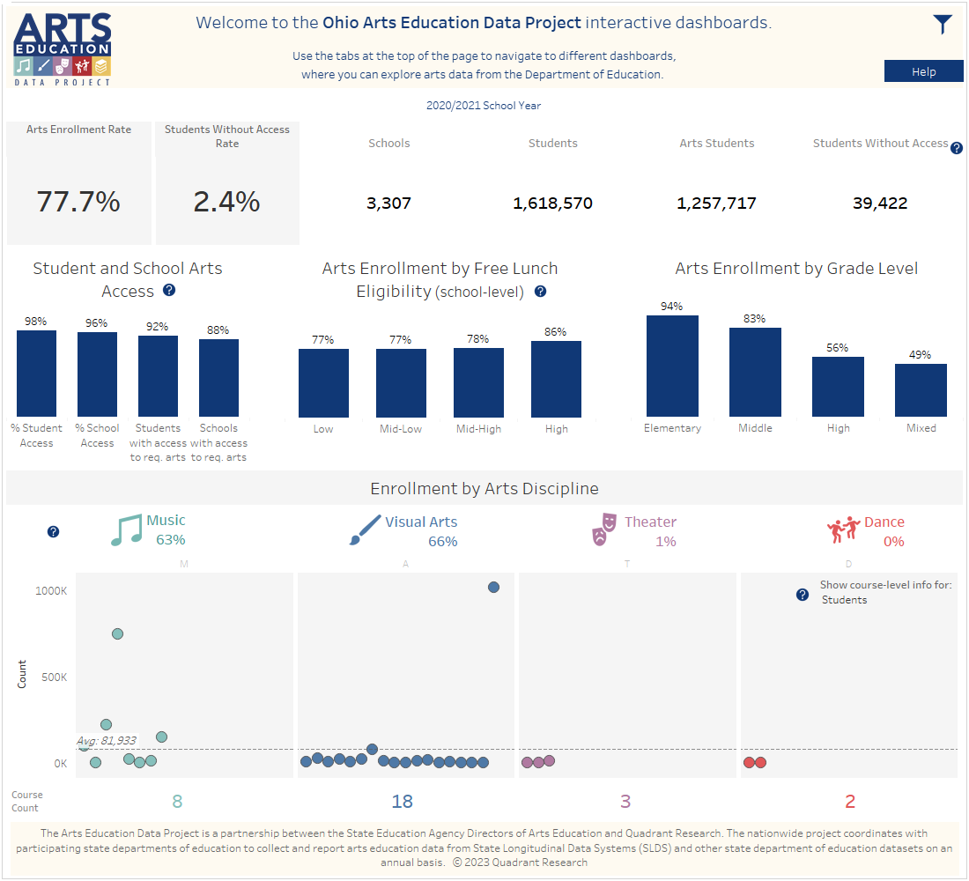
Overview Dashboard
Percentage of arts enrollment
Percentage of students with no arts access
Enrollment by arts discipline

Slide 16
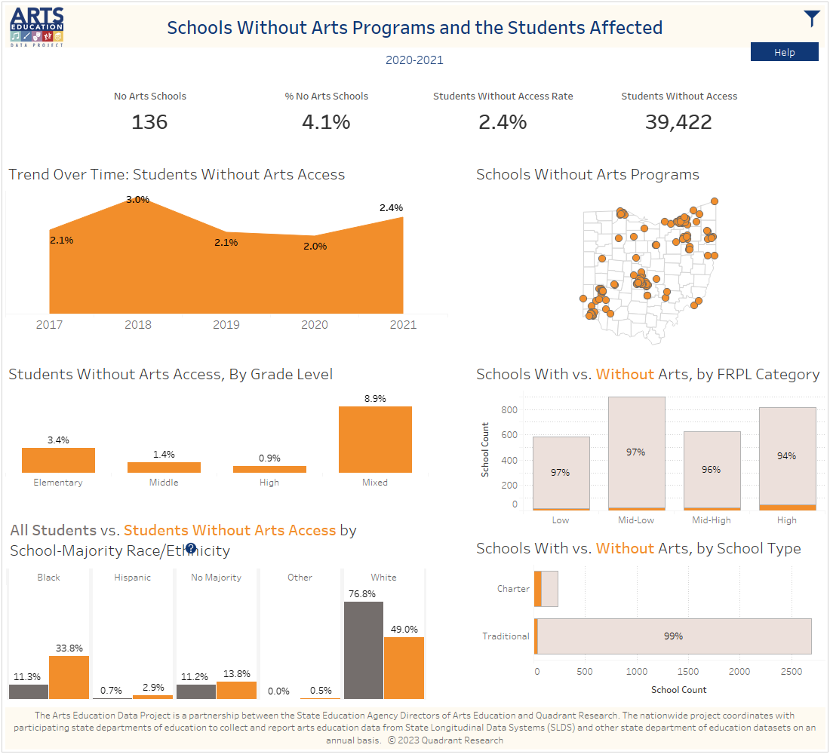
Students without Arts Programs
Black students over-represented
Hispanic students over-represented
Charter students over-represented

Slide 17
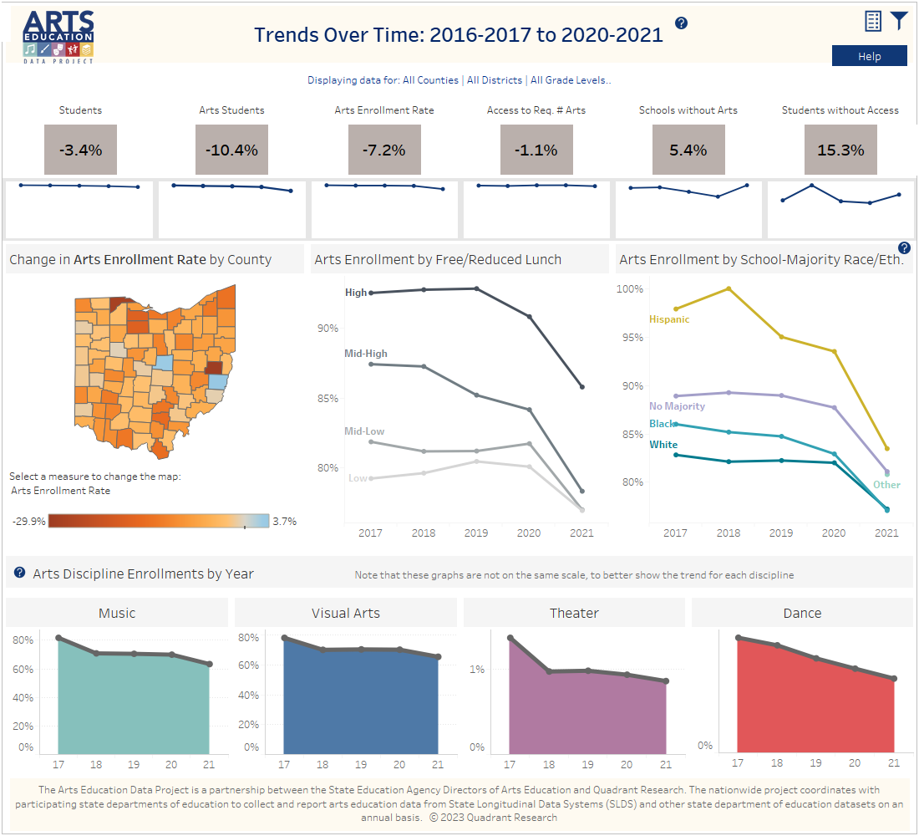
Trends over Time
What do you notice?

Slide 18
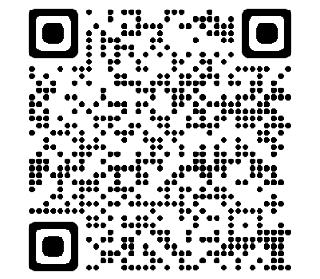
Exploration Time
District-Level Arts Tab
Sort to fine YOUR district
FIND:
  What disciplines are offered?
  What is the percent of students enrolled in arts courses?
Scan the QR Code to view Ohio's Arts Education Data Dashboard

Slide 19
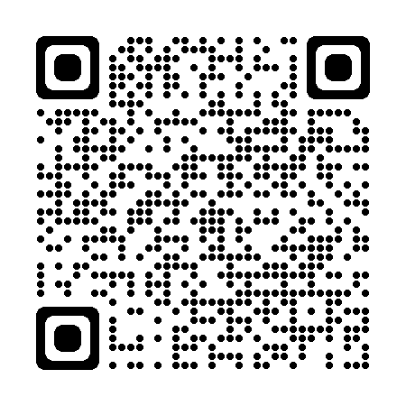

Teaching Artist Roster
Scan the QR Code to view Ohio’s Teaching Artist Roster
Notes:
Directory – Arts Learning Directory (ohioartscouncil.org)
Arts Learning Directory (ohioartscouncil.org)

Slide 20
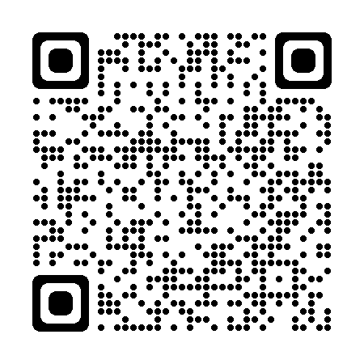
Kennedy Center for the Performing Arts
Scan the QR Code to view the Kennedy Center for the Performing Arts Education Resources
Notes:
Kennedy Center Education (kennedy-center.org)
Resources for Educators | Kennedy Center (kennedy-center.org)
Digital Resources Library (kennedy-center.org)
Lessons and Activities (kennedy-center.org)
Teaching Artists Present... (kennedy-center.org)

Slide 21
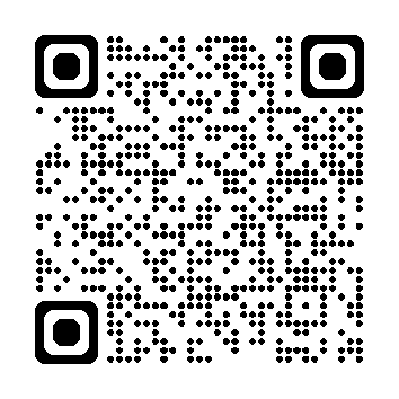
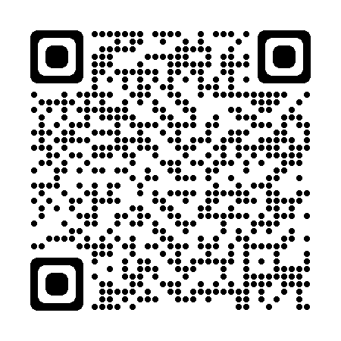
Smithsonian American Art Museum
Scan the QR Code to view the Smithsonian American Art Museums Resources
Scan the QR Code to view the Smithsonian Learning Lab
Notes:
Education | Smithsonian American Art Museum (si.edu)
Smithsonian Learning Lab: Discover, Create, Share (si.edu)

Slide 22
Save the Date
June 5-6, 2024
Mansfield, OH
Arts Integration Professional Development Conference

Slide 23

Exit Ticket
At first, I thought _____.
But now, I think _____.
And I will use this new knowledge to _____.

Slide 25

Contact Fine Arts
Helen Buck-Pavlick, M.F.A., M.Ed.
Fine Arts Education Specialist
Helen.Buck-Pavlick@education.ohio.gov

Slide 27
References
American Academy of Arts and Sciences [AAAS] (2021). Art for Life’s Sake: The Case for Arts Education. Cambridge, MA.
Bowen, D. H., & Kisida, B. (2021). The arts advantage: Impacts of arts education on Boston students. EdVestors. https://www.edvestors.org/wpcontent/uploads/2021/04/ The-Arts-Advantage-Impacts-of-Arts-Education-on-BostonStudents.pdf
Bureau of Economic Analysis. (2022, Mar 15) Arts and Cultural Production Satellite Account, U.S. and States, 2020 https://apps.bea.gov/data/special-topics/arts-and-culture/summary-sheets/Arts%20-%20Ohio.pdf
Deasy, R., Catterall, J., Hetland, L., & Winner, E. (2002). Critical links: learning in the arts and student academic and social development. Arts Education Partnership.
ESSA: Mapping opportunities for the arts. (2019). Distributed by ERIC Clearinghouse.
Fleming, J., Gibson, R., Anderson, M., Martin, A., & Sudmalis, D. (2016). Cultivating imaginative thinking: Teacher strategies used in high-performing arts education classrooms. Cambridge Journal of Education, 46(4), 435–453. https://doi.org/10.1080/0305764X.2015.106409
Heath, S.B, Soep, E., & Roach, A. (1998). Living the arts through language-learning: A report on community-based organizations. Americans for the Arts 2(7), 1-20
Ludwig, M., Boyle, A., & Lindsay, J. (2017, November 7). Review of Evidence: Arts Integration Research Through the Lens of the Every Student Succeeds Act. American Institutes for Research. ESSA Arts Evidence Review Report (wallacefoundation.org)
Ludwig, M., Hare Bork, R. (2018, March 10). Research on arts integration – An ESSA evidence review. Arts Education Partnership’s State Policy Symposium. https://www.wallacefoundation.org/knowledge-center/pages/research-on-arts-integration-presentation.aspx McIntosh, E. (2015). Why we need the arts: John Macmurray on education and the emotions. Educational Philosophy & Theory, 47(1), 47– 60. https://doi-org.ezproxy1.lib.asu.edu/10.1080/00131857.2013.866533
Méndez Martínez, E., & Fernandez-Rio, J. (2021). Effects of a theatrical improvisation programme on students’ motor creativity. Research in Drama Education, 26(2), 268–282. https://doi.org/10.1080/13569783.2020.1847064
National Coalition of Core Arts Standards. (n.d.) National core arts standards: A conceptual framework for arts learning. https://www.nationalartsstandards.org/content/national-core-arts-standards
National Coalition for Core Arts Standards. (2012). Child development and arts education: A review of current research and best practices. advocacy.collegeboard.org/preparation-access/arts-core
National Endowment for the Arts. (2019, March 19). Latest data shows increase to U.S. economy from Arts and Cultural Sector. Latest Data Shows Increase to U.S. Economy from Arts and Cultural Sector. Retrieved April 26, 2022, from https://www.arts.gov/about/news/2019/latest-data-showsincrease-us-economy-arts-and-cultural-sector
Norville, V. (2018). Focusing on gaps in access to arts education. State Innovations. 23(1). Distributed by ERIC Clearinghouse. Robinson, A. (2013). Arts integration and the success of disadvantaged students: A research evaluation. Arts Education Policy Review, 114(4), 191– 204. https://doi.org/10.1080/10632913.2013.826050
The President’s Committee on Arts and the Humanities. (2011). Re-Investing in arts education: Winning America’s future through creative schools. Summary and recommendations. Distributed by ERIC Clearinghouse.
Todhunter-Reid, A. (2019). In-school arts education and academic achievement: A child fixed effects approach. Arts Education Policy Review, 120(2), 112–119. https://doi.org/10.1080/10632913.2018.1423595
van de Kamp, M.-T., Admiraal, W., van Drie, J., & Rijlaarsdam, G. (2015). Enhancing divergent thinking in visual arts education: Effects of explicit instruction of meta-cognition. British Journal of Educational Psychology, 85(1), 47–58. https://doi.org/10.1111/bjep.1206
Wan, Y., Ludwig, M., & Boyle, A. (2018, November 29). Review of Evidence: Arts Education Through the Lens of ESSA. American Institutes for Research. Arts Education Evidence Report (wallacefoundation.org)

Slide 28






@OHEducation

Slide 29

Other Approaches
PBL
STEM/STEAM
Arts-Integration

Slide 30
Compare Logic Models
Creative Process
Generate Idea(s)
Design Process
Research
Scientific Method
Observation/Question
Engineering Process
Identify the Problem
Define
Ideate
Prototype
Test
Organize
Rehearse/Research
Refine
Perform/Present
Research & Brainstorm
Build
Test
Improve
Present Solutions
Research
Hypothesis
Experiment
Analysis
Conclusion

Slide 31
Arts Integration = Collaboration
  Classroom Teacher
  Arts Education Teacher
  Teaching Artist

Slide 32




Three Strands of Work
Overcoming Obstacles to Learning
Accelerating Learning
Preparing Students for Future Success

Slide 33

Future Forward Ohio Priorities
1. Literacy
2. Accelerate Learning
4. Student Wellness
3. Workforce Readiness

Slide 34

ESSA & Evidence

