Slide 2
2025 Out of school time conference
Communities of Practice
Sara Watson & Hearcel Craig Jr.
February 11, 2025
2:15 – 3:15 pm

Slide 3

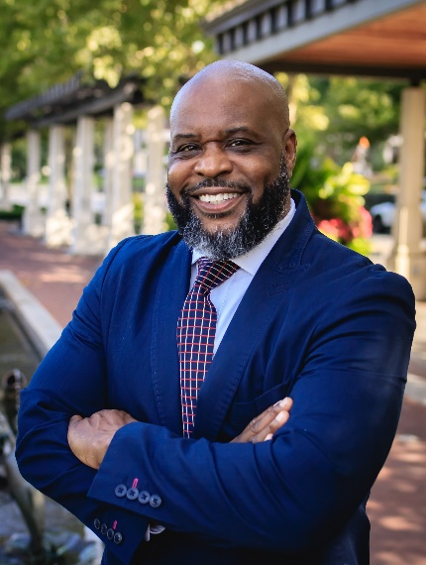
Today’s presenters
Sara Watson
Grants Manager,
Office of Graduate Success
Hearcel Craig Jr.
School Counselor Liaison, Office of Graduate Success

Slide 4


Office of graduate success: communities of practice

Slide 5
Career readiness supports
How do you support students in career connected learning through after school programs?
What do you need in order to be able to support students in career connected after school activities?

Slide 6
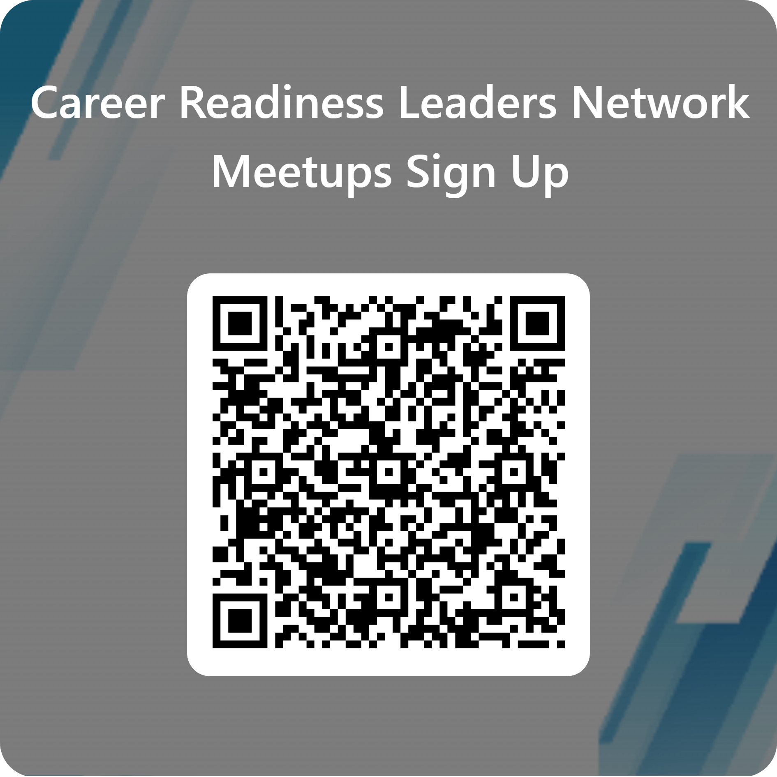
Career readiness leaders network meetups
These meetups connect leaders across the state to discuss and share best practices for engaging students in career-connected education and advising.
Hosted virtually on the second Tuesday of each month 2:30-3:30pm.

Slide 7







techcorps.org | @techcorpsus
Carla Easley
Chief Operating Officer
Notes:
TECH CORPS is a national nonprofit organization founded by Gary Beach, Publisher Emeritus of CIO Magazine and the author of The U.S. Technology Skills Gap.
Gary believed that technology professionals could be a tremendous resource to schools – if, they could be effectively connected.
In 1995, TECH CORPS was launched to be that connector, and since that time more than 15,000 technology professionals in the U.S. have shared their time and talents assisting schools with technology-related projects.

Slide 8
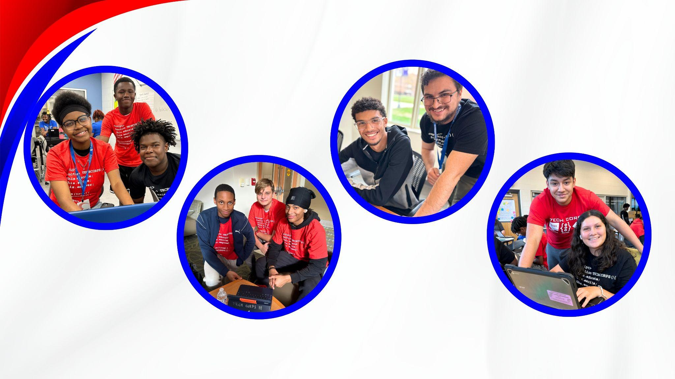
TECH CORPS believes that all students should have access to high-quality, career-connected, learning experiences.
Professional development for educators ensures program instruction is connected to student learning.
Students make connections between technology and educational and career pathways.
Programming is delivered in safe and supportive learning environments.
Students graduate high school
prepared to pursue technology degrees and careers.
Notes:
Although TECH CORPS implements a myriad of different programs, today, I’m going to specifically talk to you about two of our work-based learning programs: Student TECH CORPS and Student WEB CORPS.

Slide 9

TECH CORPS incorporates best practices in career-connected learning to prepare students for success after high school.
Industry-Informed Learning: Lessons are enhanced with real-world insights from industry experts.
Hands-On Experiences: Students gain practical skills through simulated work environments and projects.
Networking: Students connect with technology professionals who provide guidance and inspiration.
Industry-Recognized Credentials: Students can earn valuable certifications to boost their career prospects.
Inclusive Environments: Programs are designed to be accessible and equitable for all students.
Paid Opportunities: Students gain valuable work experience while earning financial compensation.
Notes:
TECH CORPS’ high school programs equip students with work-based learning hours, the OhioMeansJobs-Readiness Seal, a pre-apprenticeship certificate, and industry-recognized credentials.

Slide 10

Student TECH CORPS provides students with tech support training and empowers them to run a simulated tech support help desk.
Technology
Training
Certifications and Pre-Apprenticeship
Career Exposure & Meaningful Compensation
Students receive tech support training in hardware, operating systems, software applications, networking, computer peripherals, troubleshooting, basic programming, databases, and customer relations.
Industry-Recognized Certification (CompTIA IT Fundamentals) and Pre-Apprenticeship Certificate in IT Career Cluster.
Tech industry volunteers serve as mock clients to program participants.
Students earn an hourly wage during this 6-8 week program and learn valuable technology and employability skills.

Slide 11

Notes:
https://youtu.be/MdV8Zmer5IM?si=ViW7fzJlkDEbuZtL

Slide 12
Student WEB CORPS immerses students in a hands-on web development experience in a simulated work environment.
Technology & Project Management Training
Pre-Apprenticeship
Career Exposure & Meaningful Compensation
Pre-Apprenticeship Certificate in IT Career Cluster.
Tech industry volunteers serve as mock clients to program participants.
Students earn an hourly wage during this 7 week program and learn valuable technology and employability skills.
Through hands-on experience in web development, project management, and professional skills training, students work in project teams to create and build websites for mock businesses.

Slide 13

Notes:
https://youtu.be/TnsevH5pN_E

Slide 14

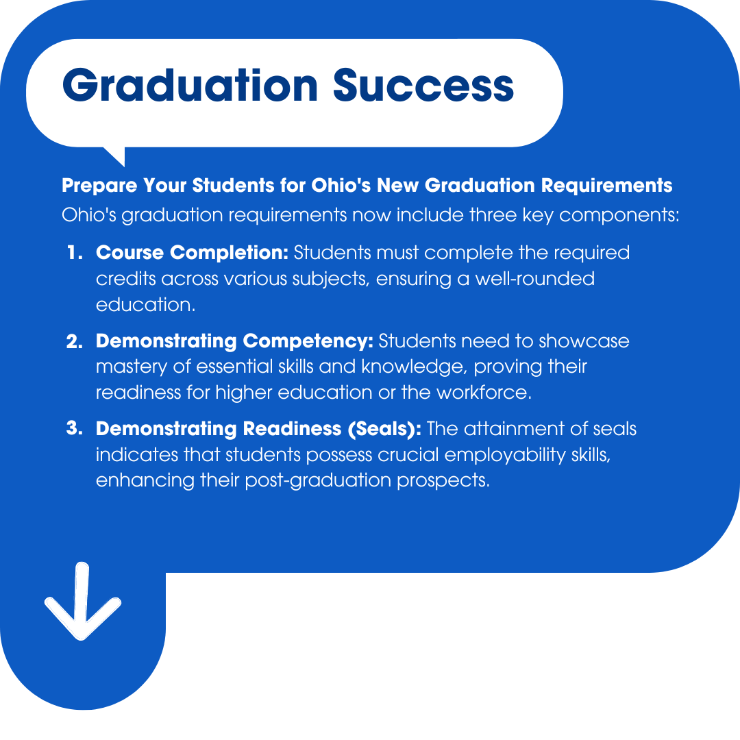
March 2024: TECH CORPS' Student TECH CORPS and Student WEB CORPS programs were approved by Franklin University and ApprenticeOhio as registered pre-apprenticeship programs.
Summer 2024: More than 100 students earned the Pre-Apprenticeship certificate in the Information Technology career cluster through these programs.
Summer 2024: 46% of the students who sat for the CompTIA Industry-Recognized Credential passed the exam.
Notes:
Although TECH COPRS has run both of these programs for nearly 15 years, in 2024, they were approved for pre-apprenticeship and work-based learning hours.

Slide 15

The students reported a remarkably positive shift in their skills, attitudes, and perceptions.
"The connections I built with the instructors helped me discover who I am and became the first step in starting my tech career."
Hussein (Grade 12)
Cornerstone Academy HS
“I can take the skills that I’ve learned through this program into any career I choose!”
Erica (Grade 10)
Firelands HS
“Through this program, I gained self-esteem and confidence. My team asked me for help and that's a good feeling.”
Abby (Grade 11)
LCCC Early College HS
"This program has given me control over my future. I’ve discovered how much I love being a leader and learned how to help others make the most of their skills."
Asman (Grade 12)
Horizon HS
10

Slide 16
techcorps.org | @techcorpsus
Carla Easley
ceasley@techcorps.org

Slide 17
Career readiness leaders network meetups
We bring organizations like TECH CORPS to our meetups to connect career readiness leaders across the state to supports.
Past topics and presenters include...
  DriveOhio
  Adopt a Class
  Opportunities for Ohioans with Disabilities
  Business Advisory Councils
  Federal Reserve Bank of Cleveland

Slide 18
History of Career readiness leaders network meetups
Started in 2019 – 2020 school year
50 – 80 attendees each meetup
Mix of attendees:
  Traditional Classroom Teachers & Career Tech Instructors
  Administrators
  Business Partners
  Educational Supports (TechPrep, ESC, SST, etc.)
  & more

Slide 19







Ohio department of education and workforce
Network Leads
Dennis Haft
Pathways Implementation Specialist
Kayla Mack
Career Advising Program Specialist
Michelle Washington
Business & Education Program
Specialist
Sara Watson
Grants Manager
Travis Taylor
Graduation and College
in High School Administrator
Sarah Redick
STEM Program Specialist
Emma Waymire
Work-Based Learning
Program Specialist
Notes:
Tasha

Slide 20




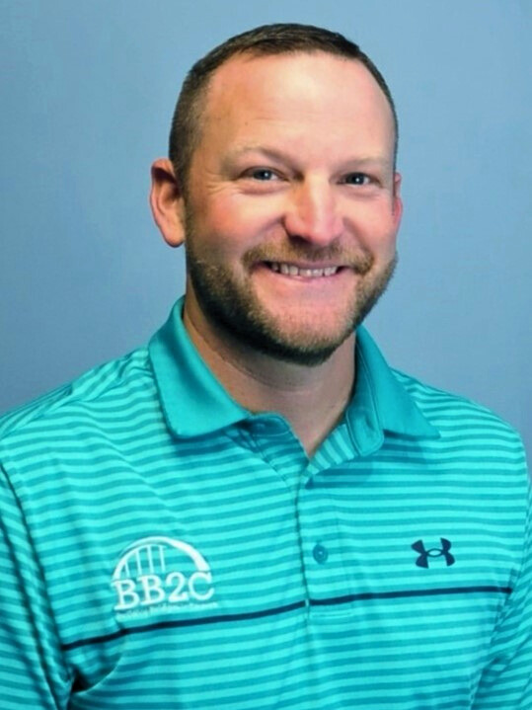

Network Leads from across the state
Tippi Foley
ESC of Northeast Ohio
Bryan Stewart
Montgomery County ESC

Slide 21
2025 Meetup Schedule and topics
February 11, 2025: Work-Based Learning
March 11, 2025: Work-Based Learning Continued
  In-person at the ESC of Central Ohio
April 15, 2025: Topic TBD
May 13, 2025: Summer Resources for Students and Educators
  This is our final meetup of the 24-25 school year! We will resume in September 2025 for the 25-26 school year.

Slide 22
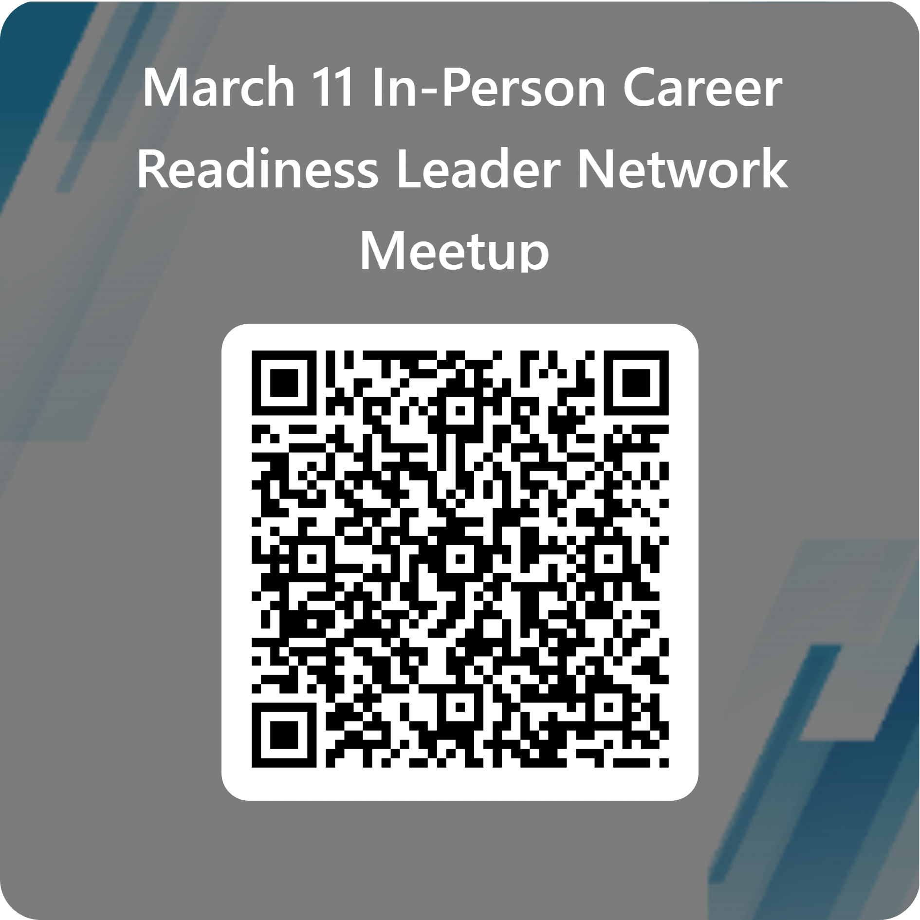
March in person sign up
Join is March 11 at the ESC of Central Ohio 12:30 – 4:00pm to continue our conversation around work-based learning!
More details to come.

Slide 23
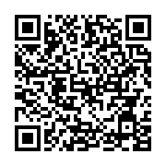
Openspace
We utilize OpenSpace to keep track of all the resources shared in meetups.
  Join the community of Ohio’s Career Readiness Leaders to connect and share best practices!

Slide 24
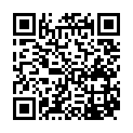
Career connections GovDelivery
Publish monthly editions about career connected opportunities across the State!
  Funding Opportunities
  Professional Development Opportunities
  Student Supports
  & more!
Enter your email and select 'Career Connections updates'

Slide 25
School counselor supports
How are your school counselors engaged in supporting after school programs?
Do after school programs contact school counselors?
Do after school programs engage school administrators?

Slide 26
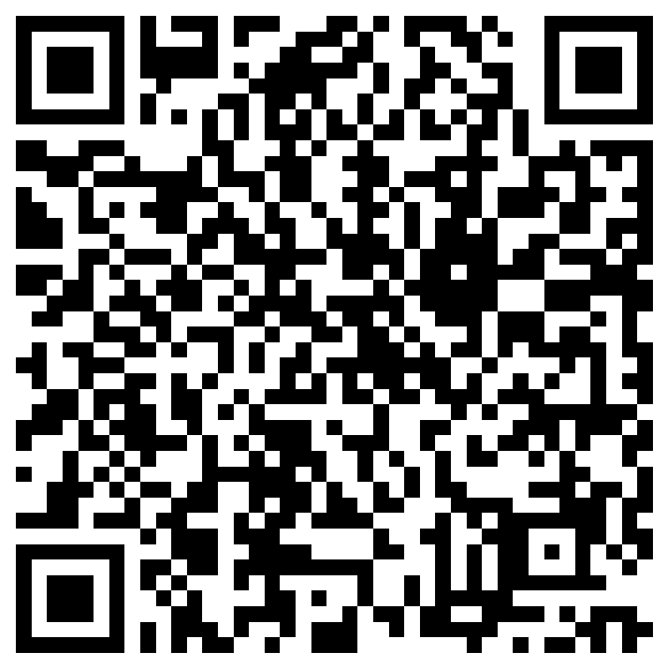
School Counselor Supports
School Counselor Updates Subscription: Please visit Ohio Department of Education and Workforce Subscriptions to register and sign up to receive our “School Counselor Updates”
Recorded Sessions of School Counselor Meetups: School Counselor Meetups | Ohio Department of Education
School Counselor Meetups: Please sign up to attend our 2024-2025 School Counselor Meetups.
Notes:
Travis

Slide 27
History of school counselor meetups
Partner with Ohio School Counselor Association (OSCA) to put on these meetups since their inception in 2021!
Over 100 attendees each meetup!
School counselors are typical attendees – all are welcome!

Slide 28
Past school counselor topics
FAFSA
Creative Ways to Reach Your Youngest Learners
Career Exploration for Elementary Schools
School Counselors as Family Engagement Leaders
College Credit Plus
& more!

Slide 29
Future school counselor meetups
All meetups take place at 11:00am!
  February 13, 2025: Helping Build Resilience in Students that Experienced Trauma
  February 20, 2025: New Honors Diploma
  TBD: Reimagining Education, NCH4/ day-1/ day Blended Learning
  March 20, 2025: AI Tools for School Counselors

Slide 30
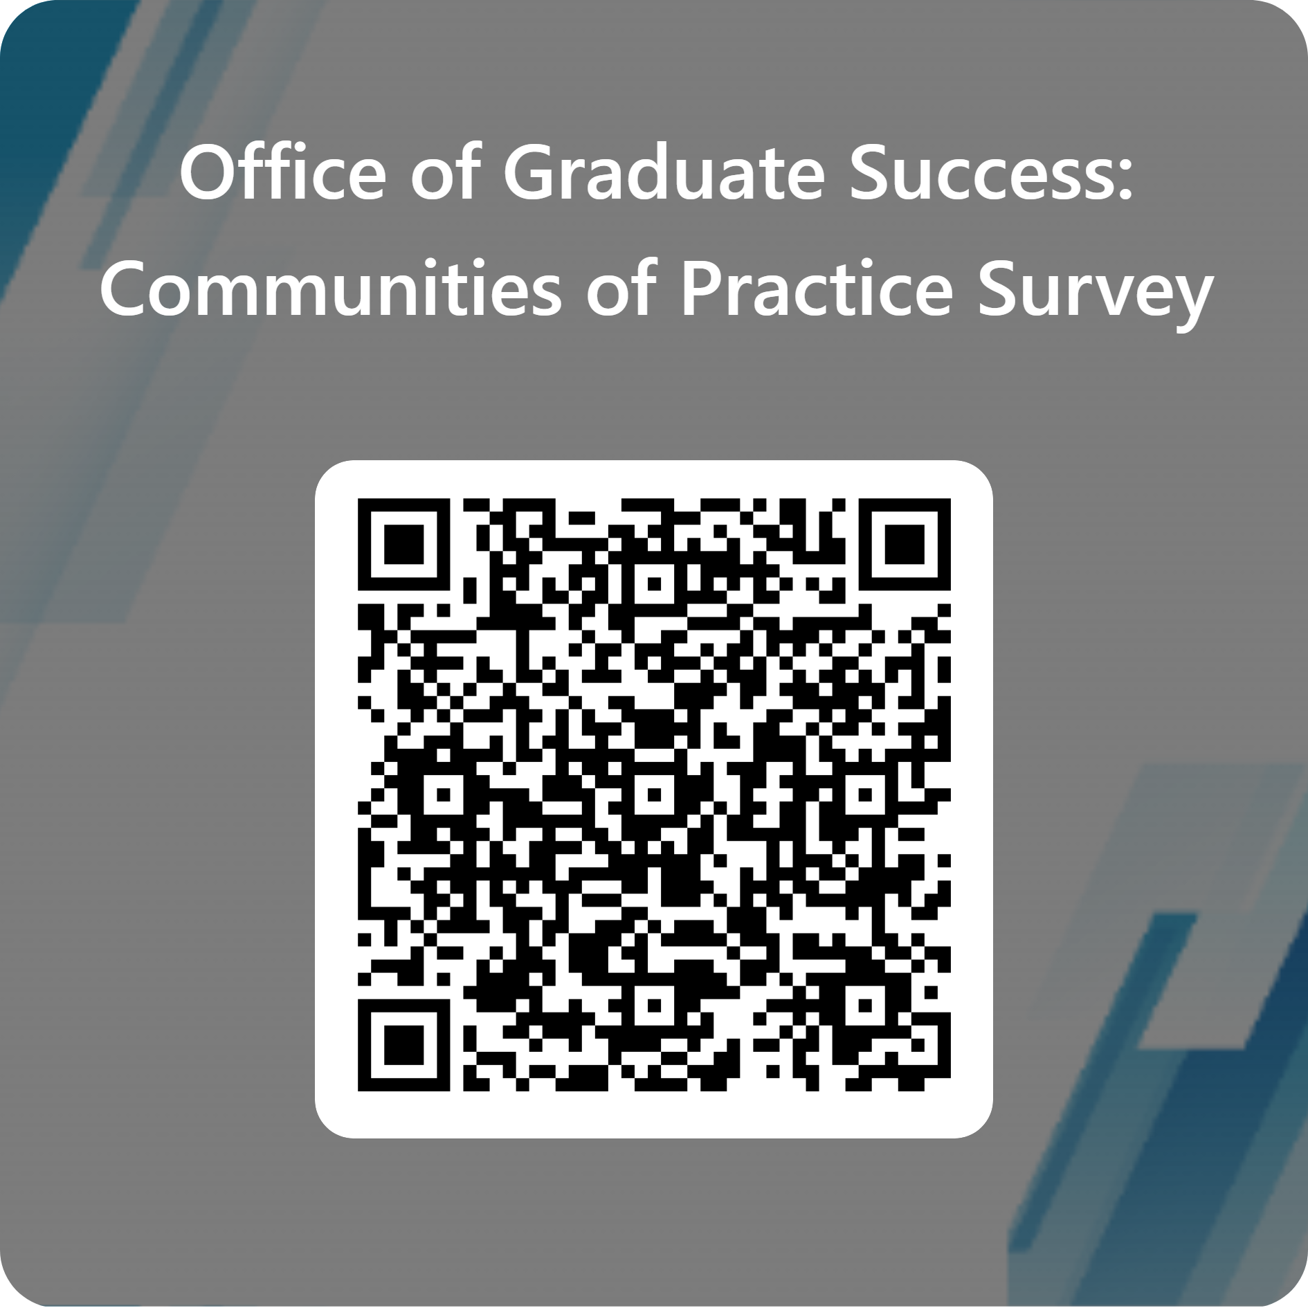
Future topics survey
Stakeholders like yourself guide our meetups - we want to hear from you!

